Slide 2
How to implement queue using linked list
struct node
{
int data;
struct data *next;
} *front,*rear;
front=rear=NULL;

Slide 3
Enqueue using Linkedlist
void enqueue()
{
int x; struct node *newnode;
newnode=(struct node *)malloc(sizeof(struct node ));
printf(“Enter the value\n”);
scanf(“%d”,&x);
newnode->data=x;
newnode->next=NULL;
if(front==NULL) { front=newnode; rear=newnode; }
else { rear->next=newnode; rear=newnode; }
}

Slide 4
dequeue using Linkedlist
void dequeue()
{
if(front==NULL) { printf(“Queue is empty”);}
else if (front->next==NULL ) {
printf(“%d”,front->data); front=rear=NULL; }
else
{ struct node *temp; temp=front; front=temp->next;
Temp->next=NULL; free(temp); temp=NULL; }
}

Slide 5
display using Linkedlist
void display()
{
if(front==NULL) { printf(“Queue is empty”);}
else
{ struct node *temp; temp=front;
while(temp!=NULL) {
printf(“%d\t”, temp->data);
temp=temp->next; }
}
}

Slide 6
Peek operation using Linkedlist
void peek()
{
if(front==NULL) { printf(“Queue is empty”);}
else
{ printf(“%d”,front->data); }
}

Slide 7
Introduction
The efficiency of an algorithm depends on the amount of time, storage and other resources required to execute the algorithm.
The efficiency is measured with the help of asymptotic notations.
An algorithm may not have the same performance for different types of inputs. With the increase in the input size, the performance will change.
Prior Analysis:
Prior analysis involves predicting the performance of an algorithm before its execution, often using theoretical models and asymptotic analysis.
Posterior Analysis:
Posterior analysis involves evaluating the actual performance of the implemented algorithm based on real-world data or empirical measurements.

Slide 8
Time Complexity and Space complexity
Time complexity is a measure of the amount of time an algorithm takes to complete as a function of the size of its input.
It provides an estimate of the computational efficiency of an algorithm.
The space Complexity of an algorithm is the total space taken by the algorithm with respect to the input size. Space complexity includes both Auxiliary space and space used by input.
Auxiliary Space is the extra space or temporary space used by an algorithm.

Slide 9
Asymptotic notation
Asymptotic notation is a mathematical notation used to describe the limiting behavior of a function as its input approaches infinity.
It is commonly used in computer science and mathematics to analyze the efficiency and performance of algorithms.
The three most common asymptotic notations are big O, big Omega, and big Theta
Big O Notation (O):
Denoted as O(f(n)), it represents the upper bound or worst-case scenario of an algorithm's time complexity.
It describes the maximum growth rate of the algorithm as the input size increases.

Slide 10
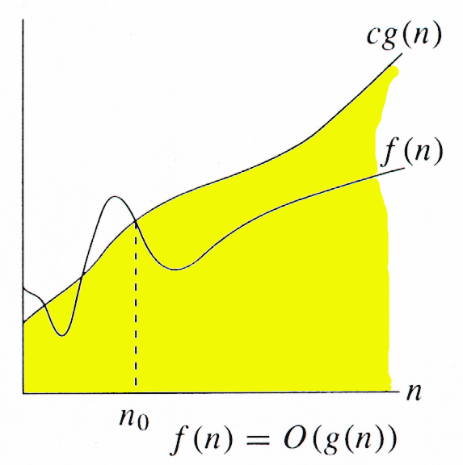
O -notation
For function g(n), we define O(g(n)), big-O of n, as the set:
O(g(n)) = {f(n) : ∃ positive constants c and n_{0,} such that ∀n ≥ n₀,
we have 0 ≤ f(n) ≤ cg(n) }
Intuitively: Set of all functions whose rate of growth is the same as or lower than that of g(n).

Slide 11
Big omega Notation (Ω):
Denoted as Ω(g(n)), it represents a lower bound on the growth rate of a function.
Ω(g(n)) defines a lower limit for the function f(n), such that there exist constants c and n₀, where f(n) is always greater than or equal to c * g(n) for all n ≥ n₀.
qIt describes the best-case scenario of an algorithm's time complexity.
Big Theta Notation (Θ):
Denoted as Θ(f(n)), it represents both the upper and lower bounds of an algorithm's time complexity.
It provides a tight bound on the growth rate of the algorithm.

Slide 12
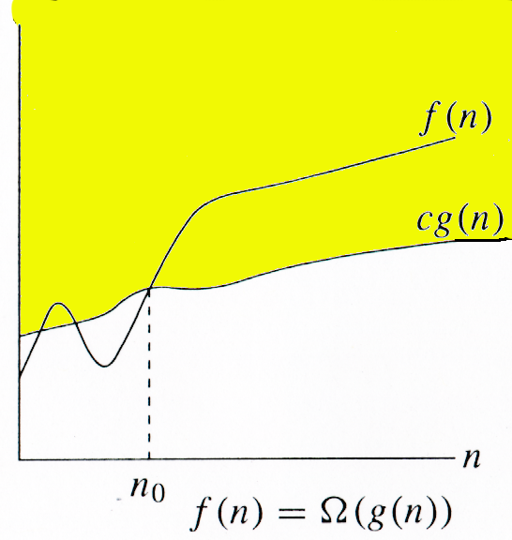
Ω -notation
For function g(n), we define Ω(g(n)),
big-Omega of n, as the set:
Ω(g(n)) = {f(n) : ∃ positive constants c and n_{0,} such that ∀n ≥ n₀,
we have 0 ≤ cg(n) ≤ f(n)}
Intuitively: Set of all functions whose rate of growth is the same as or higher than that of g(n).

Slide 13
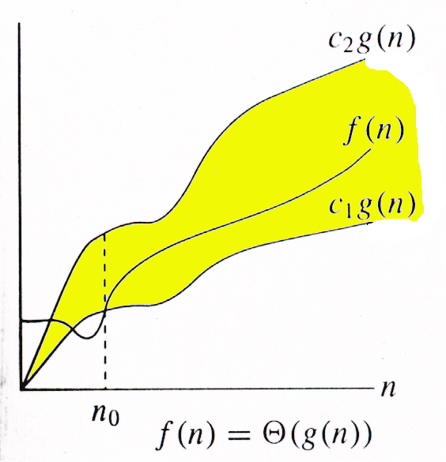
Θ-notation
For function g(n), we define Θ(g(n)),
big-Theta of n, as the set:
Θ(g(n)) = {f(n) : ∃ positive constants c₁, c₂, and n_{0,} such that ∀n ≥ n₀,
we have 0 ≤ c₁g(n) ≤ f(n) ≤ c₂g(n)
}
Intuitively: Set of all functions that
have the same rate of growth as g(n).

Slide 14
Classifications of Algorithms
Iterative Algorithm:
An iterative algorithm is a computational procedure that repeats a set of instructions or steps until a specific condition is met.
Recursive Algorithm:
A recursive algorithm, which call themselves to break down a problem into smaller subproblems

Slide 15
Example 1
A(n)
{
for( i=0;i<=n;i++)
{
printf(“Save me ”);
}
}

Slide 16
Example 2
A(n)
{
for( i=0;i<=n;i++)
{
for(j=0;j<=n;j++)
printf(“Save me ”);
}
}

Slide 17
Example 3
A(n)
{
i=1,s=1;
while(s<=n)
{
i++;
s=s+i;
printf(“save me”);
}

Slide 18
Example 4
A(n)
{
i=1;
for(i=1;i*i<=n;i++)
{
printf(“save me”);
}
}

